Slide 1

Fast Food Analysis
Analyzing Fast Food chains against population demographics and health data in California
By: The Git Pandas
Dominica Corless, Jeremy Steele,
Jeremy Jang, Stanley Tan & Kelsey Cox

Slide 2

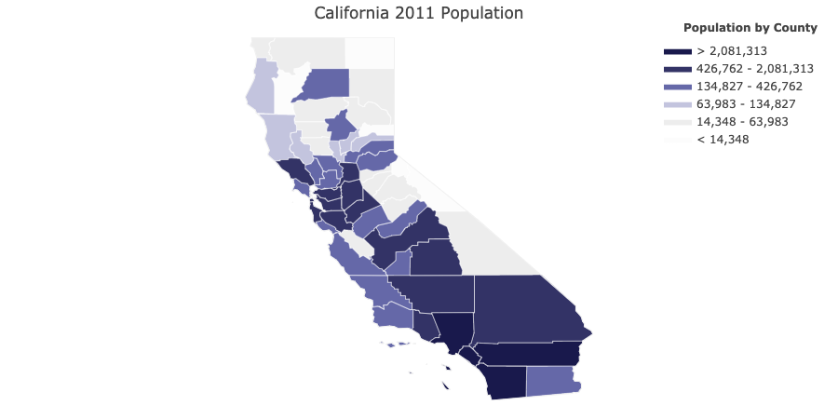
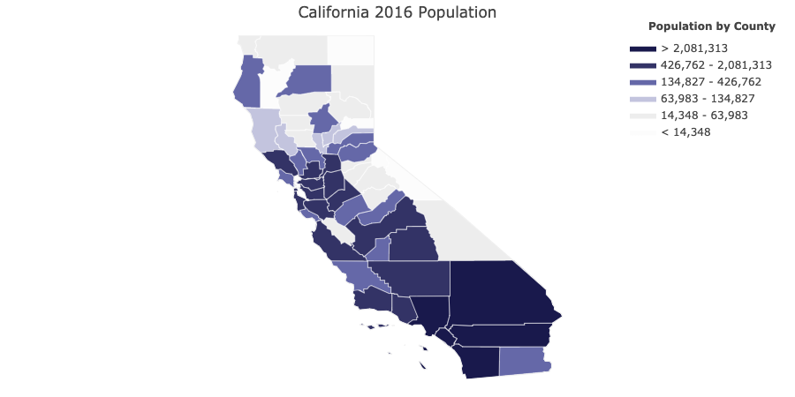
California Populations by County

Slide 3
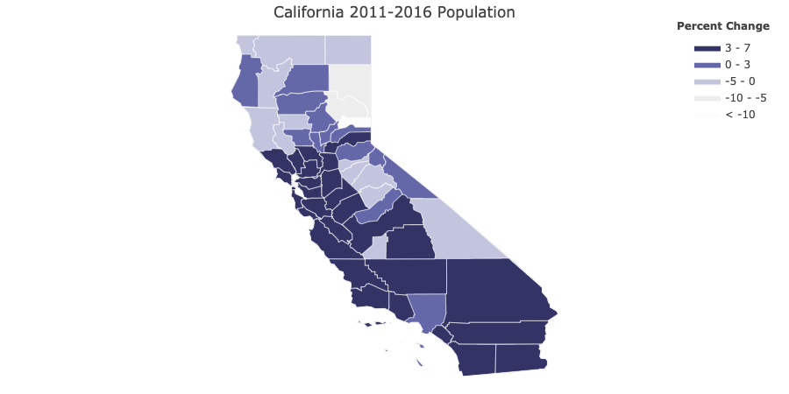
Population Change
Majority of California counties experienced a 3-7% change between the years 2011 to 2016.

Slide 4
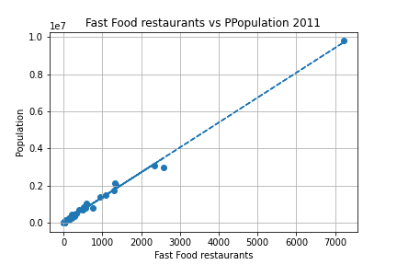
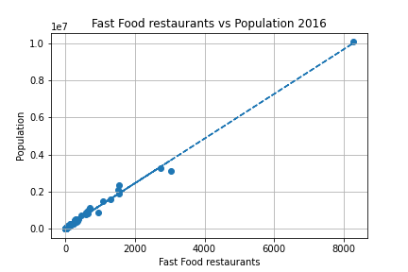
Fast Food Restaurants compared to population

Slide 5
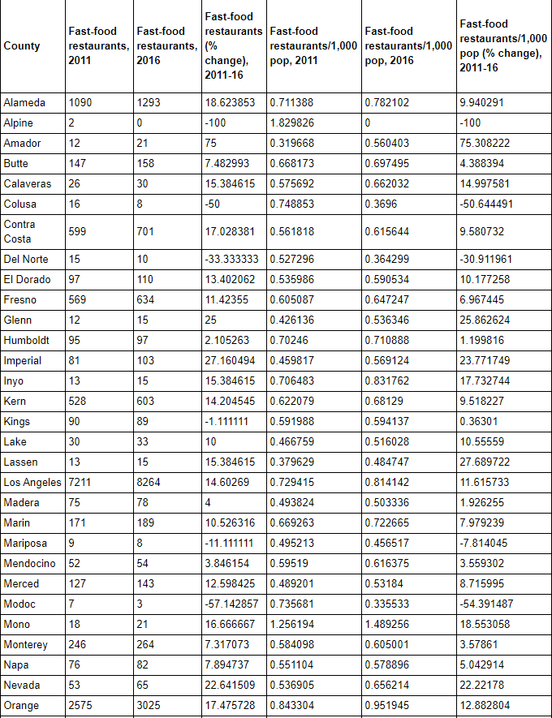
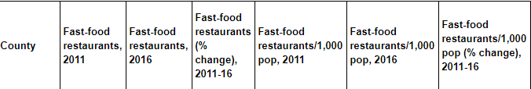
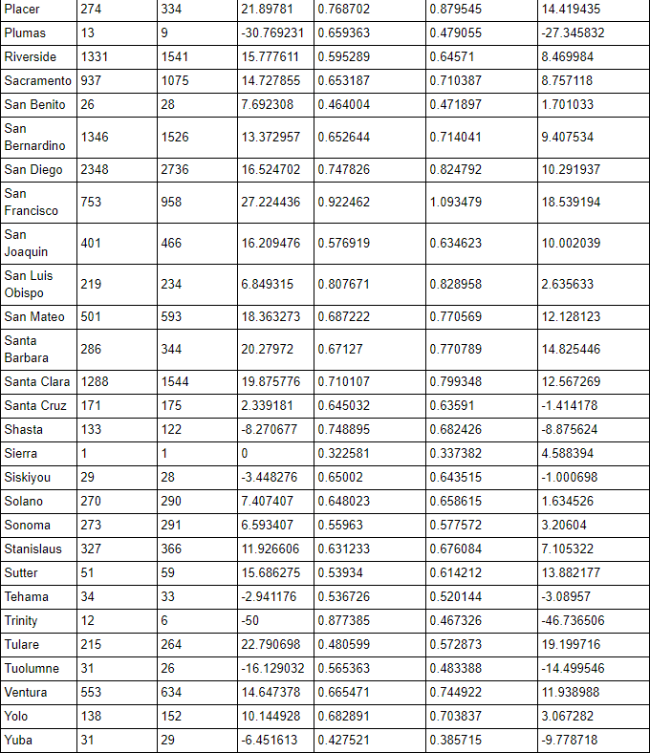
Fast Food Restaurants Per County in California

Slide 6
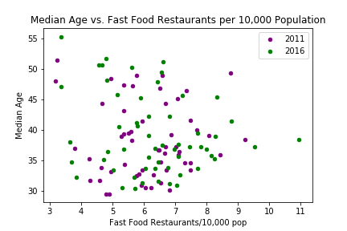
*Including this on here for now. Correlation looks a little weak…Maybe add a line?

Slide 7
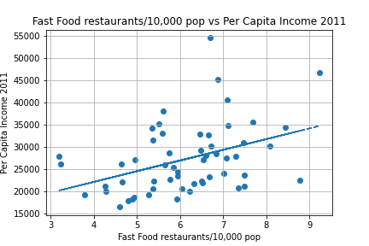
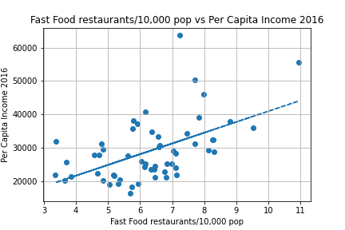
FAST Food Restaurants vs Income Per Capita

Slide 8
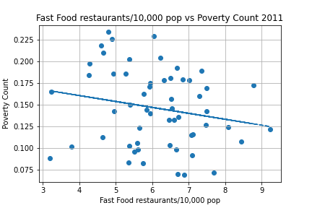
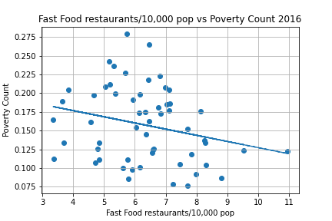
FAST Food Restaurants vs Poverty Count

Slide 9
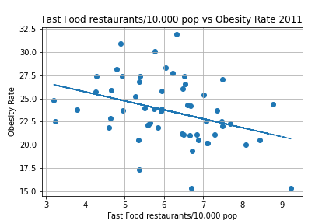
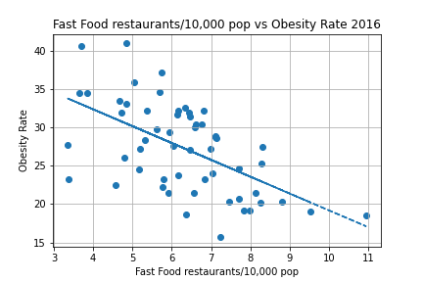
Health Data – Obesity
*Comment

Slide 10
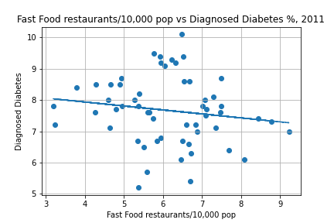
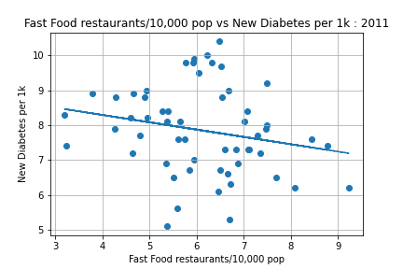
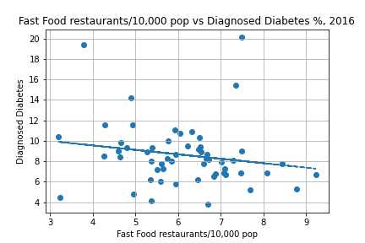
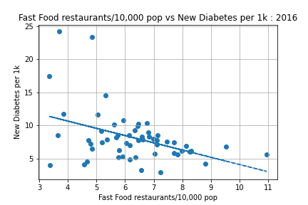
Health Data – Diabetes
*Not sure which charts want to be used for this slide

Slide 11
Conclusions
2011
2016

Slide 12
Data Sources:

